Slide 1


Visitor Management System
SUPERVISOR Mr.A.MALARMANNAN.M.E., AP/CSE.
PRESENTED BY
2303811710421143 – SHARARASAN S

Slide 2

PRESENTATION OVERVIEW
Objective
Project introduction
Problem statement
Methodologies (programming concepts relevant to problem statement)
Architecture of the proposed system
list of modules
Merits
Results and discussion
Queries

Slide 3
OBJECTIVE
The primary objective of the above code is to design a Visitor Management System using Java's AWT (Abstract Window Toolkit) framework. The system aims to provide a streamlined solution for managing visitor information in real-time.
Efficient Registration:
Allow visitors to register their name, contact details, and purpose of visit.
Automatically log the check-in time.
Real-time Check-out:
Enable visitors to check out, recording their exit time accurately.
Comprehensive Visitor History:
Maintain a detailed log of all visitors, including check-in and check-out times.
Provide secure access to historical data using an admin password.
User-friendly GUI:
Offer an intuitive and interactive interface for ease of use.

Slide 4
PROJECT INTRODUCTION
The Visitor Management System is a Java-based application designed to simplify the process of registering, tracking, and managing visitors. Utilizing the AWT framework, the system provides an intuitive graphical interface for real-time check-ins, check-outs, and record-keeping. It eliminates the ensures accurate data handling, and enhances operational efficiency with secure visitor data storage and easy retrieval. This project demonstrates the practical use of Java concepts to solve real-world problems effectively.

Slide 5
PROBLEM STATEMENT
Manual visitor management is inefficient and error-prone.
Lack of real-time tracking and data security.
Difficulty in maintaining accurate visitor records.
Need for an automated, efficient system for visitor check-ins and check-outs.

Slide 6
Methodologies (Programming concepts relevant to problem statement)
Object-Oriented Programming (OOP): Encapsulation of visitor details into a Visitor class for better organization and reusability.
Event-Driven Programming: Handles user interactions like button clicks for check-in, check-out, and history retrieval.
Java AWT (GUI): Provides an interactive interface using buttons, text fields, and labels.
Date & Time Management: Accurate check-in/out timestamps using LocalDateTime.
Validation & Security: Ensures data integrity with input validation and admin password protection.

Slide 7
FLOW DIAGRAM
Vistor Management System
User input
Name-Number-Purposes
History(Visitor)
Check in & Check Out
Admin Password
Show Details
Date & Time
7

Slide 8
MODULE DESCRIPTION
Visitor Registration
Captures details like Name, Contact, and Purpose.
Automatically logs the check-in time.
Visitor Check-Out
Updates records with check-out timestamps.
Current Visitors Display
Lists all visitors currently checked in.
Visitor History (Password Protected)
Displays the complete log of all visitors, including check-in and check-out times.

Slide 9
MERITS
Instant Visitor : Real-time check-in and check-out ensures up-to-date information about current visitors.
Efficient Queue Management: Reduces wait times by promptly processing visitor registrations.
Immediate Data Access: Admins can instantly retrieve visitor details or history.
Dynamic Updates: such as visitor check-out, instantly to maintain accurate records.

Slide 10
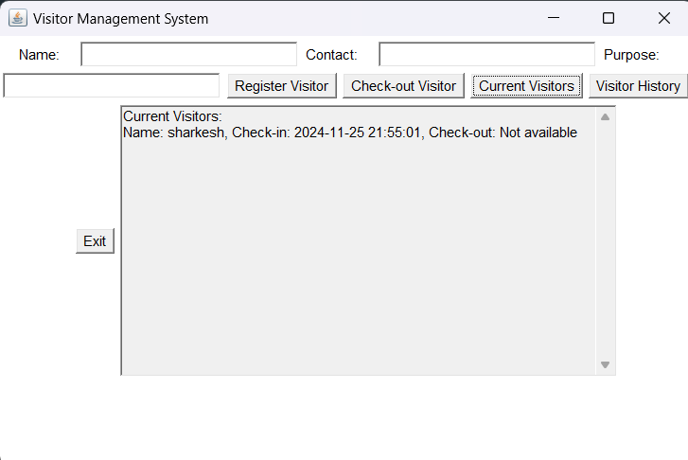
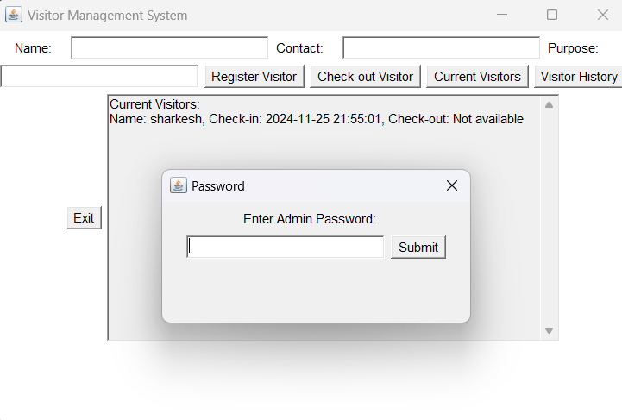
RESULT AND DISCUSSION

Slide 11
ANY QUERIES ?

Slide 12
THANK YOU

